Slide 1
Before we start; please make sure you have R and Rstudio installed and the github cloned

Slide 2
Proteogenomics
Workshop Lead: Thomas Zheng
Date: August 12th, 2025

Slide 3

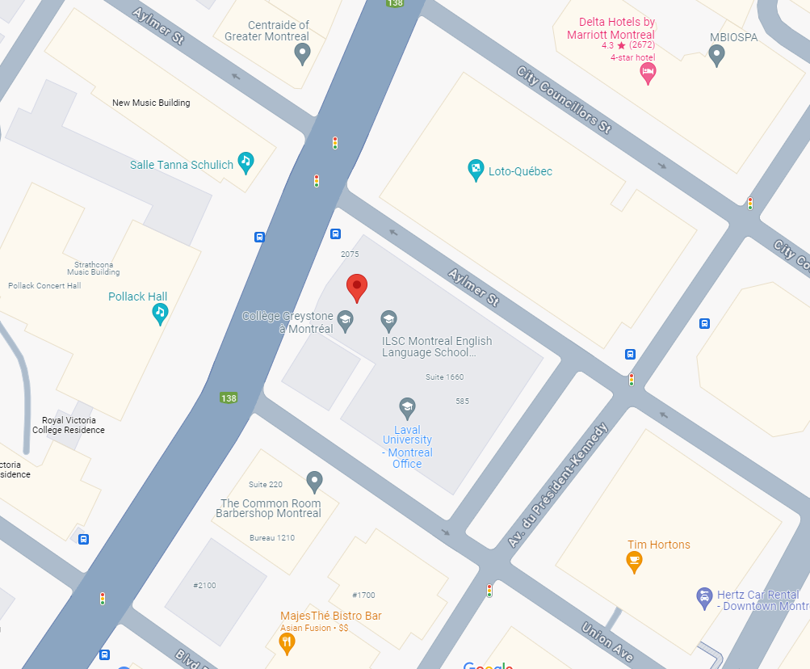

Mission statement: deliver quality workshops designed to help biomedical researchers develop the skills they need to succeed.
Location: 550 Sherbrooke Street, Montreal, Quebec
Scan the QR code to sign up
for our mailing list
Contact: workshop-micm@mcgill.ca

Slide 4

Upcoming Fall Series!
We will be partnering with the Canadian Bioinformatics Hub and bioinformatics.ca for an Intro to R bootcamp!

Slide 5


Upcoming Fall Series!

Slide 6
Upcoming Fall Series!
An RNA-seq bootcamp is also in the works for the fall semester

Slide 7
Outline
Intro to Proteomics
Aptamer vs. Antibody Proteomics
Somalogic Data Processing
Association Testing & Multiplexing
Association Testing
Hands-On
pQTLs
Cis and Trans pQTLs
Hands-On
Olink Data Processing
Multiple Comparison Correction
Hands-On
Conclusion

Slide 8
But first!
Does everyone have Rstudio working and R working?
Can you access the Rmarkdown (.Rmd) file?
Can you access the data files associated with this workshop?
Notes:
Maybe take a minute or two here

Slide 9
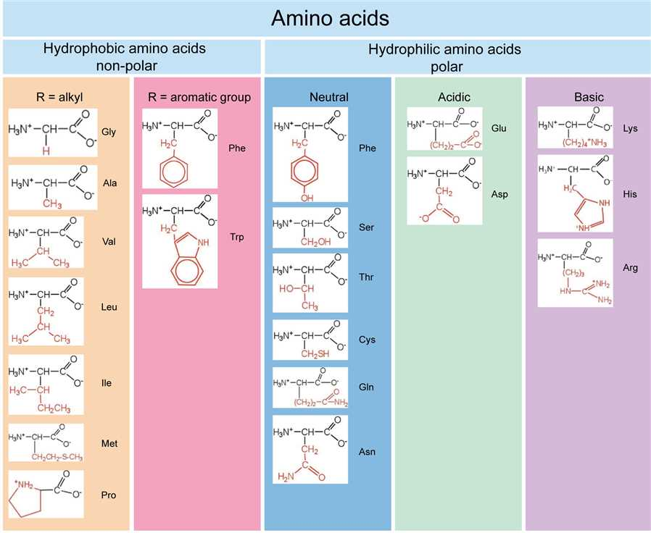
Crash Course/Recap on Biochemistry
Proteins are composed of amino acids

Slide 10
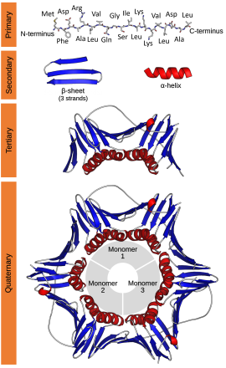
Crash Course/Recap on Biochemistry
Protein structure has 3-4 levels from primary, secondary, tertiary, and quaternary
These structures are dependent on various molecular forces

Slide 11
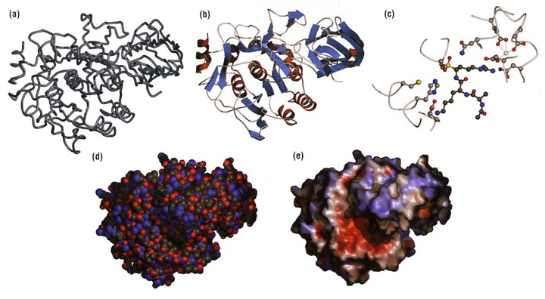
The outer structure of a protein is dependent on the tertiary structure

Slide 12
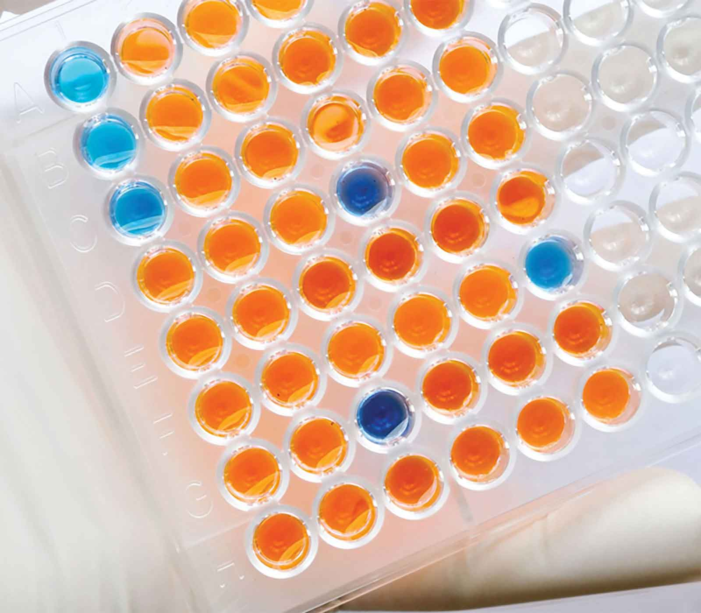
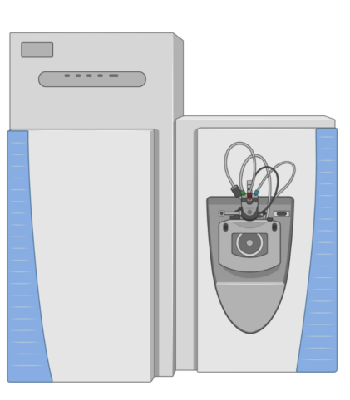
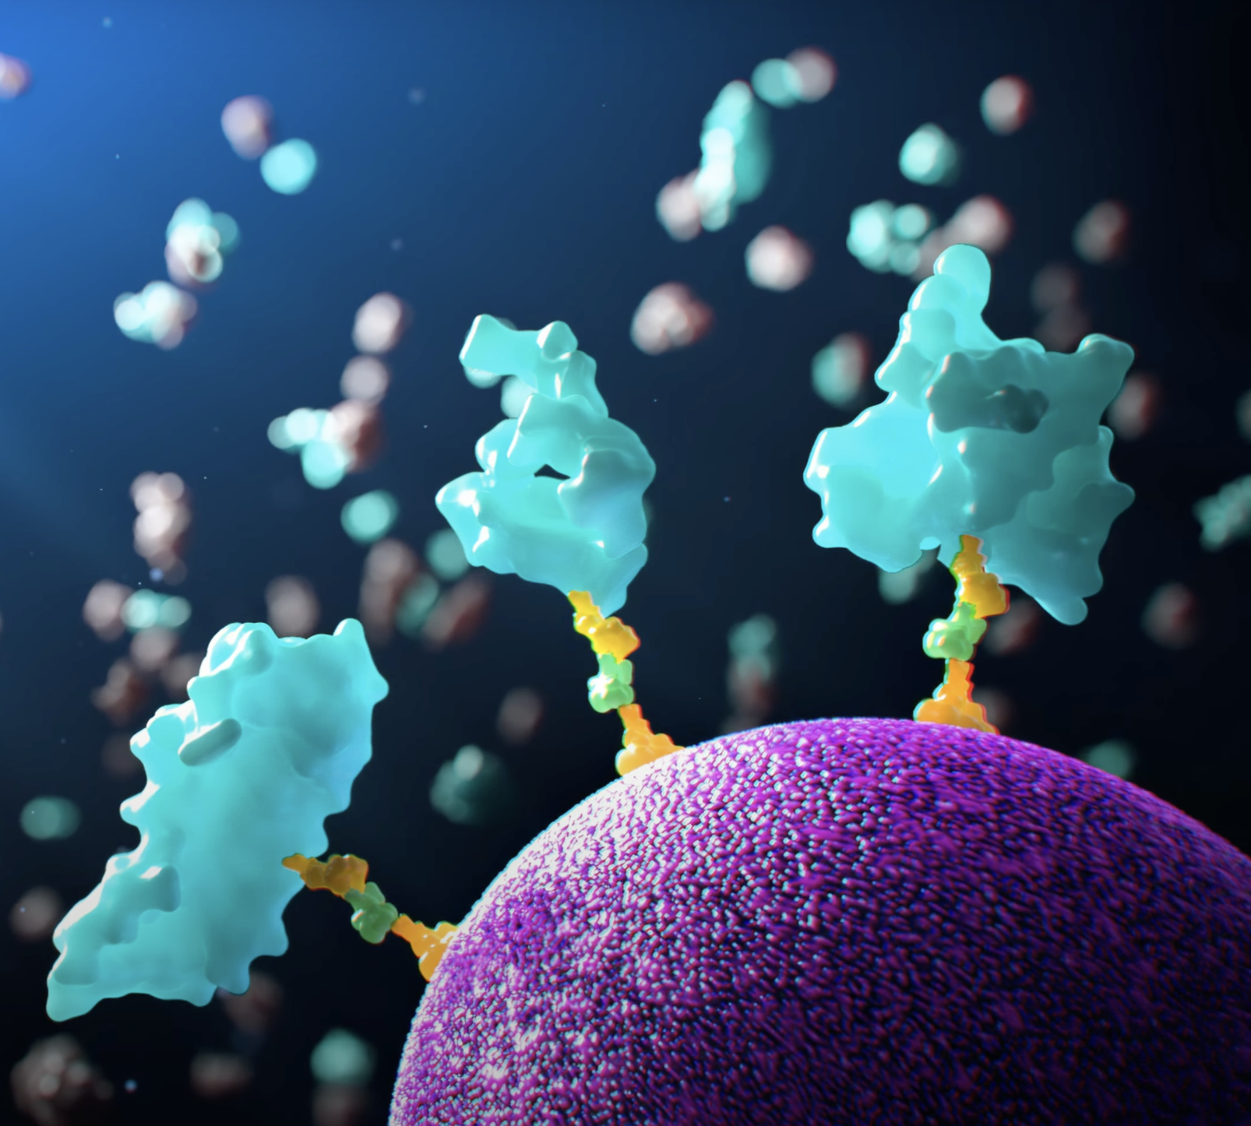
What is Proteomics?
The (large-scale) study of proteins
Targeted Proteomics
Multiplex Proteomics
ELISAs
Mass spectrometry based
Affinity based
Figure inspired by Dr. Christopher Whelan

Slide 13
What is Proteomics?
The (large-scale) study of proteins
Targeted Proteomics
Multiplex Proteomics
ELISAs
Mass spectrometry based
Affinity based
Figure inspired by Dr. Christopher Whelan

Slide 14
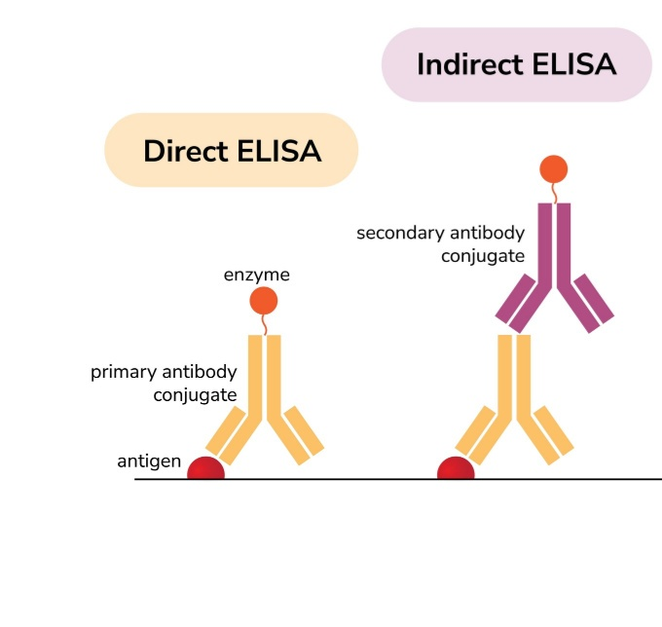
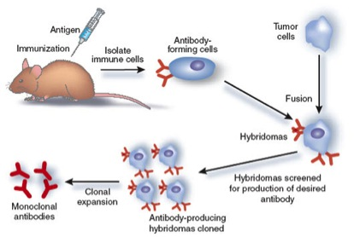
ELISA/Small-Scale Antibody Protein Analysis
Notes:
ELISA = Enzyme linked immunosorbent assay

Slide 15
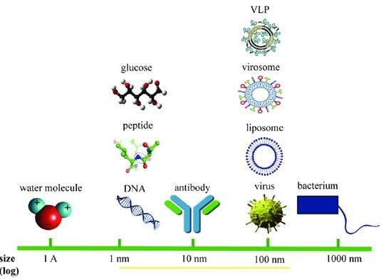
Antibodies are big!

Slide 16
What is Proteomics?
The (large-scale) study of proteins
Targeted Proteomics
Multiplex Proteomics
ELISAs
Mass spectrometry based
Affinity based
Figure inspired by Dr. Christopher Whelan

Slide 17
Mass Spec. Proteomics
We could host an entire workshop on just MS Proteomics
Samples can be identified by extremely accurate mass spectra
We have MALDI-MS, ESI-MS, AP-MS, MS/MS, HPLC-MS/MS, etc…
The most similar MS to the other assays is MS/MS

Slide 18
Tandem MS (MS/MS or MS²)
Used to determine the proteomic composition of the sample
Can even find mutations, PTMs, and non-protein molecules
Limited to isotopic or barcode multiplexing

Slide 19
What is Proteomics?
The (large-scale) study of proteins
Targeted Proteomics
Multiplex Proteomics
ELISAs
Mass spectrometry based
Affinity based
Figure inspired by Dr. Christopher Whelan

Slide 20
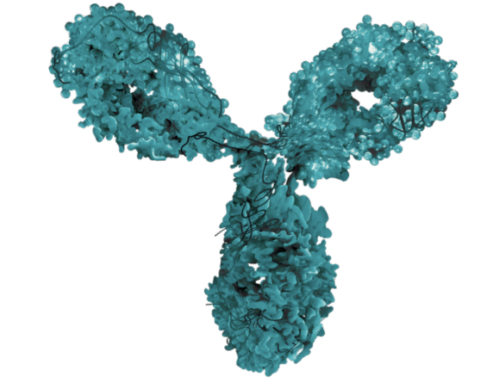
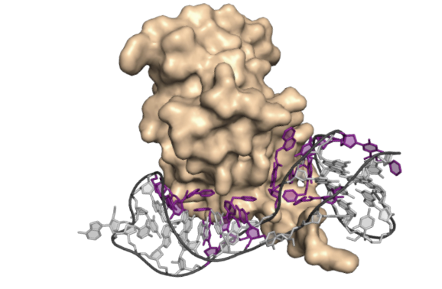
Affinity-based Proteomics
Olink
Antibody-based
PEA - system
Somalogic
Aptamer-based
SOMAmer - system
Images from Somalogic

Slide 21
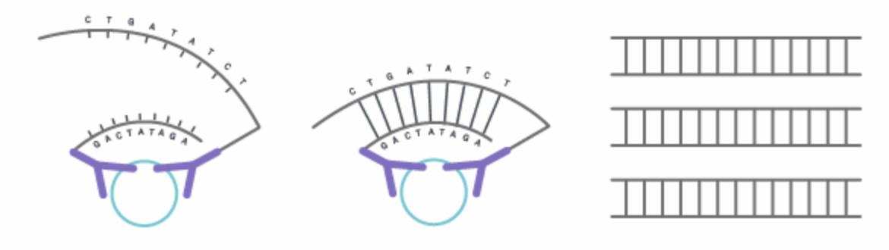
Olink
PEA – Proximity Extension Assay
Uses two matched antibodies with complementary DNA fragments

Slide 22
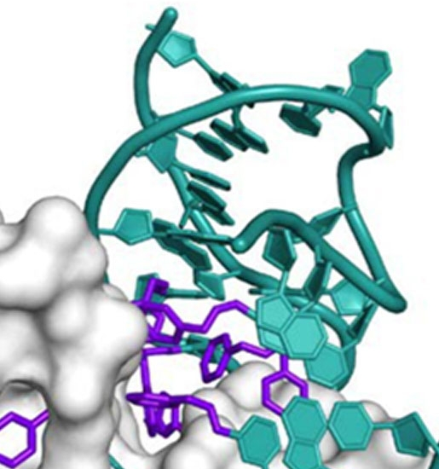
Somalogic
SOMAmer – Slow Off-rate Modified Aptamer
Uses ssDNA with modified hydrophobic bases to form a binding reagent
Use a polyanionic competitor to wash off any sticky proteins

Slide 23
What is Proteomics?
The (large-scale) study of proteins
Targeted Proteomics
Multiplex Proteomics
ELISAs
Mass spectrometry based
Affinity based
Figure inspired by Dr. Christopher Whelan

Slide 24
What is Proteomics?
The (large-scale) study of proteins
Targeted Proteomics
Multiplex Proteomics
ELISAs
Detects one or a handful of proteins
Need to know what you are looking for in advance
Mass spectrometry based
Affinity based
Figure inspired by Dr. Christopher Whelan

Slide 25
What is Proteomics?
The (large-scale) study of proteins
Targeted Proteomics
Multiplex Proteomics
ELISAs
Detects one or a handful of proteins
Need to know what you are looking for in advance
Mass spectrometry based
Unbiased and very accurate
Requires large volumes
Not very scaleable
Affinity based
Figure inspired by Dr. Christopher Whelan

Slide 26
What is Proteomics?
The (large-scale) study of proteins
Targeted Proteomics
Multiplex Proteomics
ELISAs
Detects one or a handful of proteins
Need to know what you are looking for in advance
Mass spectrometry based
Unbiased and very accurate
Requires large volumes
Not very scaleable
Affinity based
Has a bias present
Requires very small volumes
And can detect very low amounts of protein
Figure inspired by Dr. Christopher Whelan

Slide 27
Why are affinity-based proteomics considered biased?
Dependant on a binding interaction
If a mutation changes the binding site but not the function – we can get a different result
If a mutation changes the function but not the binding or expression level – we get a different result

Slide 28
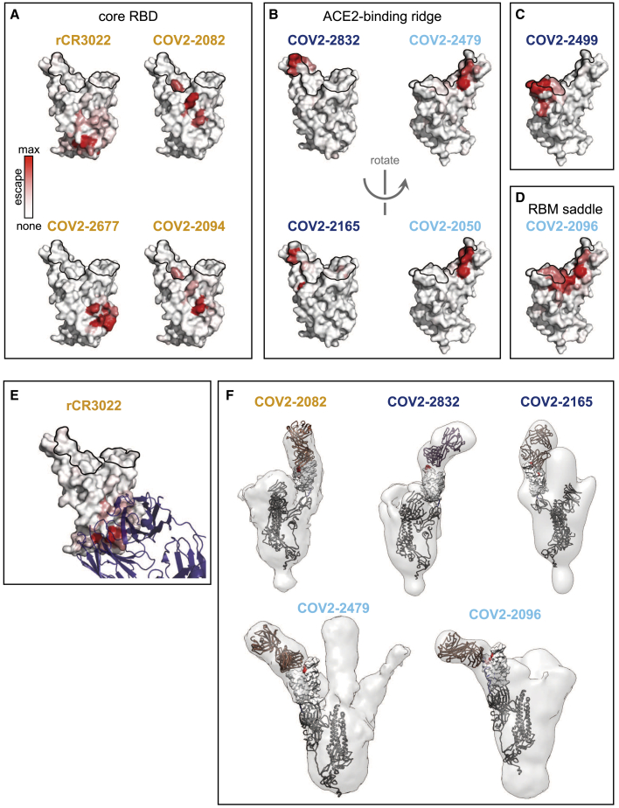
Why are affinity-based proteomics considered biased?
Dependant on a binding interaction
If a mutation changes the binding site but not the function – we can get a different result

Slide 29
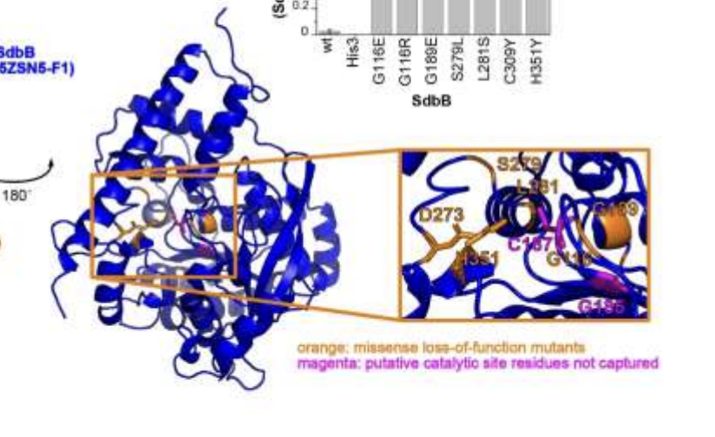
Why are affinity-based proteomics considered biased?
Dependant on a binding interaction
If a mutation changes the function but not the binding or expression level – we get a different result

Slide 30
Outline
Intro to Proteomics
Aptamer vs. Antibody Proteomics
Somalogic Data Processing
Association Testing & Multiplexing
Association Testing
Hands-On
pQTLs
Cis and Trans pQTLs
Hands-On
Olink Data Processing
Multiple Comparison Correction
Hands-On
Conclusion
Notes:
10 minutes? Slow Down if not

Slide 31
Somalogic’s Data Format
Comes in the .adat format
Tab-delimited format
Constructed to be flexible and self-describing
They have the following four sections
Header
Column Data
Row Data
Table

Slide 32
Header
Contains all of the study information
ADAT ID
Version
Assay Type
Creation Date
Technician Name
Run Information
Calibrator Info
Normalization Info
Data processing steps

Slide 33
Column Info
Name associated with the SOMAmer
Sequence ID
SomaID
Target Name
UniProt/EntrezGeneID
Organism
Dilution
Calibration/Reference

Slide 34
Row Info
Name associated with the sample tested
Plate ID and Run Date
Plate & Slide Position
Sample ID & Type
Normalisation Scale
ANML Fraction
Other Notes

Slide 35
SeqId | 10000-28 | 10001-7 | 10003-15 | 10006-25 | 10008-43 | 10010-10 | 10011-65 | 10012-5 | 10013-34 | 10014-31 | 10015-119 | 10021-1 | 10022-207 | 10023-32 | 10024-44 | 10025-1 | 10030-8 | 10034-16 | 10035-6 | 10036-201 | 10037-98 | 10039-32 | 10040-63 | 10041-3 | 10042-8
SeqIdVersion | 3 | 3 | 3 | 3 | 3 | 3 | 3 | 3 | 3 | 3 | 3 | 3 | 3 | 3 | 3 | 3 | 3 | 3 | 3 | 3 | 3 | 3 | 3 | 3 | 3
SomaId | SL019233 | SL002564 | SL019245 | SL019228 | SL019234 | SL014943 | SL019246 | SL014669 | SL025418 | SL007803 | SL014924 | SL025418 | SL019229 | SL004071 | SL019235 | SL008018 | SL006373 | SL025418 | SL007389 | SL019252 | SL025986 | SL005262 | SL007662 | SL007226 | SL015131
TargetFullName | Beta-crystallin B2 | RAF proto-oncogene serine/threonine-protein kinase | Zinc finger protein 41 | ETS domain-containing protein Elk-1 | Guanylyl cyclase-activating protein 1 | Beclin-1 | Inositol polyphosphate 5-phosphatase OCRL-1 | SAM pointed domain-containing Ets transcription factor | Fc_MOUSE | Zinc finger protein SNAI2 | Voltage-gated potassium channel subunit beta-2 | Fc_MOUSE | DNA polymerase eta | Vitamin D3 receptor | 4-hydroxy-2-oxoglutarate aldolase, mitochondrial | Dihydrolipoyl dehydrogenase, mitochondrial | Adenine DNA glycosylase | Fc_MOUSE | Dual specificity protein phosphatase 4 | Zinc fingers and homeoboxes protein 3 | Sialic acid-binding Ig-like lectin 12:Ig-like V-type 2 domain, Isoform long | Purine nucleoside phosphorylase | Tumor protein 63 | Hepatocyte nuclear factor 4-alpha | Serine/threonine-protein kinase Sgk3
Target | CRBB2 | c-Raf | ZNF41 | ELK1 | GUC1A | BECN1 | OCRL | SPDEF | Fc_MOUSE | SLUG | KCAB2 | Fc_MOUSE | POLH | VDR | HOGA1 | DLDH | MutY homolog | Fc_MOUSE | DUS4 | ZHX3 | SIG12:Ig-like V-type 2 | PNP | P73L | HNF4A | SGK3
UniProt | P43320 | P04049 | P51814 | P19419 | P43080 | Q14457 | Q01968 | O95238 | Q99LC4 | O43623 | Q13303 | Q99LC4 | Q9Y253 | P11473 | Q86XE5 | P09622 | Q9UIF7 | Q99LC4 | Q13115 | Q9H4I2 | Q96PQ1 | P00491 | Q9H3D4 | P41235 | Q96BR1
SampleId | SampleType
23 | Sample
119 | Sample
66 | Sample
46 | Sample
200169 | Calibrator
51 | Sample
174 | Sample
177 | Sample
147 | Sample
86 | Sample
200169 | Calibrator
82 | Sample
42 | Sample
37 | Sample
163 | Sample
99 | Sample
160 | Sample
137 | Sample
17 | Sample
200170 | QC
68 | Sample
24 | Sample
104 | Sample
7 | Sample
133 | Sample
118 | Sample
190063 | Buffer
81 | Sample
6 | Sample
14 | Sample
145 | Sample
45 | Sample
142 | Sample
55 | Sample
75 | Sample
190063 | Buffer
9 | Sample
515.3 | 570.3 | 136 | 579.5 | 453.4 | 322.9 | 2406.3 | 1008.8 | 376.4 | 726.9 | 634.7 | 755.3 | 182.9 | 383.7 | 540.7 | 1361.9
455.8 | 737.7 | 352.6 | 565.4 | 405.4 | 276.4 | 2276.2 | 1478.6 | 553.4 | 5444 | 659.1 | 906.9 | 158.1 | 522.1 | 601 | 1570.3
474.7 | 768.8 | 170.1 | 698.7 | 488.1 | 304.7 | 2021.3 | 1097.4 | 399.2 | 744.7 | 580.9 | 810.9 | 219.1 | 422.1 | 552.3 | 1091.8
542.1 | 881.2 | 150.8 | 602.4 | 425.1 | 299.1 | 2573.5 | 1226.4 | 405.6 | 755.3 | 615.1 | 988.3 | 202.7 | 496.7 | 545.7 | 1374.8
875 | 383.8 | 218.1 | 804 | 670.2 | 603 | 3690.5 | 1917 | 678.2 | 1347.4 | 668.9 | 1556 | 345.4 | 823.7 | 1052.7 | 1381.2
597 | 924.1 | 774.5 | 514.8 | 540.1 | 441.7 | 1310.9 | 930.7 | 502.5 | 726.3 | 828.6 | 860 | 246.4 | 466 | 591.5 | 2329.9
450.9 | 950.4 | 141.6 | 585.3 | 476.4 | 274 | 2344.3 | 1132.8 | 391.4 | 695.8 | 613.2 | 729.1 | 172.6 | 531.2 | 526.9 | 1563.9
538.7 | 306.6 | 166.1 | 585.3 | 550.9 | 336.5 | 2530.7 | 1519.7 | 517.5 | 843.6 | 537.3 | 975.2 | 359.6 | 558.1 | 693.8 | 1083.8
780.2 | 671.9 | 152 | 649.6 | 572.5 | 340.3 | 1608.7 | 1274.7 | 415.8 | 926.8 | 817.3 | 1022.4 | 139.9 | 470.3 | 650.9 | 1548.5
444.5 | 916.3 | 127.2 | 686.6 | 422.1 | 315.4 | 2471.5 | 1231.6 | 378.5 | 718.3 | 730.5 | 816.7 | 184 | 441.9 | 525.3 | 1508.9
905.4 | 384.4 | 211.8 | 815.5 | 655.4 | 637.7 | 3567.3 | 1750.1 | 679.8 | 1373.9 | 706.1 | 1695.1 | 352.2 | 848.9 | 1066.8 | 1358.3
468 | 788.3 | 139.4 | 1088.4 | 433.9 | 297 | 2160.1 | 1158.3 | 404.1 | 839.2 | 1559.1 | 783.8 | 155.5 | 482.6 | 610.6 | 1886.1
518.1 | 645.3 | 159.3 | 631.7 | 428.5 | 561 | 2248.9 | 1285.5 | 557.2 | 742.8 | 531 | 959.2 | 308 | 450.5 | 524.7 | 1701
459.3 | 509.7 | 176.1 | 590.6 | 457.9 | 298.4 | 2585.8 | 1358.2 | 451.1 | 830 | 535.8 | 820.2 | 165.9 | 531.9 | 601.8 | 1306
447.5 | 534.2 | 182.6 | 533.1 | 436.8 | 313.8 | 1953.3 | 1338.2 | 456.4 | 697.5 | 578.9 | 842.5 | 170.4 | 581.7 | 604.7 | 1865.4
444.1 | 919.1 | 164.1 | 674.1 | 434.5 | 318.5 | 1795.9 | 1061.9 | 384.6 | 2628.9 | 759.4 | 894.2 | 190.8 | 476.2 | 650.7 | 1496.5
544.1 | 993.9 | 191.9 | 602.2 | 594.2 | 285.5 | 2859.9 | 1550.2 | 508 | 825.2 | 656.3 | 957.7 | 149.3 | 567.6 | 630 | 1461.2
753.2 | 710.9 | 165.7 | 735.1 | 403.1 | 337.9 | 1830.9 | 1021.6 | 389 | 715.4 | 579.3 | 757.6 | 173.3 | 412.8 | 655.5 | 1975.8
473 | 605.2 | 165.6 | 790.7 | 502.8 | 295.6 | 2510.9 | 1355.3 | 442.5 | 751.3 | 744.5 | 912.7 | 199.7 | 548.2 | 946 | 1309.2
2324 | 338.8 | 168.6 | 556.1 | 465.2 | 313 | 2542.5 | 1188.7 | 403.2 | 801 | 573.3 | 947 | 209.2 | 451.8 | 646.7 | 1202
512.6 | 1002.6 | 164.6 | 1290.9 | 456.5 | 293.4 | 1833.2 | 1030.7 | 384.1 | 712.1 | 673.6 | 781.1 | 152.9 | 533 | 515 | 1841.6
525.7 | 1605 | 140.8 | 745.3 | 452.3 | 270.1 | 1943.5 | 1021.2 | 369.8 | 715.8 | 846.2 | 759.5 | 194.9 | 432.3 | 550.8 | 1680.1
542.5 | 1286.2 | 175.6 | 651.1 | 451.3 | 295.9 | 1927.3 | 1135.9 | 413.6 | 748.9 | 1167.4 | 948.4 | 174 | 460.4 | 1455.8 | 1949.4
705.1 | 854.3 | 209.6 | 580.3 | 481.5 | 293.7 | 6578.5 | 1242.3 | 441.6 | 787.4 | 518 | 826.9 | 159.5 | 515.2 | 682 | 1628.6
490.1 | 544.2 | 194.3 | 579.5 | 436 | 286.8 | 2760.5 | 1819.7 | 558.9 | 792.1 | 570.5 | 964.6 | 145.7 | 669.5 | 678.8 | 1291.3
493.1 | 675.2 | 227.9 | 576.6 | 504.8 | 276.4 | 2126.4 | 1183 | 408.3 | 772.1 | 593.2 | 829.6 | 159 | 505.7 | 579 | 1300.6
66 | 59.1 | 71 | 53.6 | 56.7 | 66.2 | 100.9 | 98.4 | 54.9 | 119.5 | 99.2 | 73.7 | 46.4 | 46.5 | 58.8 | 42.1
542.7 | 769.8 | 163.3 | 666.6 | 443 | 281.8 | 1913.6 | 1121.9 | 385.8 | 799.7 | 812.8 | 904.9 | 147.3 | 517.1 | 576.6 | 1651.3
469.7 | 1014.9 | 172 | 643.9 | 468.5 | 483 | 1543.6 | 1007.1 | 387.5 | 697.4 | 633.7 | 861.8 | 186.7 | 515.9 | 585.4 | 1459.1
465.4 | 1560.8 | 151.6 | 712.4 | 419.1 | 283.5 | 1894.3 | 1146.7 | 339 | 701.5 | 850.6 | 832 | 143.8 | 424.8 | 570.8 | 1526.1
430.3 | 471.2 | 205.6 | 895.9 | 550.5 | 356.8 | 1954.2 | 910.5 | 381.4 | 1451.1 | 547.9 | 784.2 | 205.5 | 476.6 | 507.5 | 1262.4
487.1 | 332.7 | 148 | 540.5 | 507.9 | 298 | 3174.1 | 1498.2 | 496.5 | 781.9 | 453.2 | 910.9 | 181.3 | 487.8 | 623 | 1376.5
494.4 | 1616.3 | 184.4 | 806 | 503.8 | 330.9 | 1687.6 | 1152.2 | 389.4 | 730.1 | 1660 | 1072.2 | 115.1 | 562.2 | 703 | 4962.4
492.6 | 1318.9 | 288.6 | 642.5 | 533.1 | 290.1 | 2514.3 | 1316.1 | 485.5 | 706.6 | 762 | 926.4 | 153.9 | 566.8 | 568.4 | 1756.8
473.9 | 771.6 | 151.4 | 601.1 | 416.2 | 299 | 2350 | 1176 | 434.9 | 725.1 | 704.2 | 1170.8 | 168.1 | 522.6 | 565.6 | 1629
70.3 | 62.9 | 77.5 | 55.3 | 57.3 | 63.5 | 99.4 | 101.6 | 54.8 | 124.5 | 97.8 | 72 | 50.3 | 48.8 | 58.3 | 40.5
452.6 | 855.9 | 168.4 | 596.7 | 456.4 | 275.6 | 2253.1 | 1258 | 630.1 | 727.7 | 682.6 | 793.4 | 168.9 | 520.6 | 536.8 | 1704.4
484.6 | 410.5 | 186.2 | 688 | 505 | 324.5 | 3095.4 | 1465.5 | 583.1 | 866.8 | 556 | 817.3 | 197.1 | 522.9 | 903.5 | 1165.5
468 | 531 | 137.2 | 654.9 | 476.7 | 382.4 | 2208.6 | 1200.1 | 435.2 | 883.8 | 596.7 | 885 | 300.6 | 481.9 | 1193 | 1412.8
530.9 | 761.2 | 156.8 | 557.3 | 580.6 | 284.4 | 3415.3 | 1581.5 | 480.1 | 761.8 | 647.4 | 914.9 | 158.9 | 567.1 | 705.2 | 1357.7
470.7 | 948.3 | 132.5 | 671.3 | 442.7 | 300.7 | 2391.6 | 1154 | 375.6 | 773.4 | 860.9 | 889.4 | 153.2 | 448.1 | 561.9 | 1386.1
442 | 975.9 | 140.7 | 609.5 | 459.8 | 282.8 | 1627.3 | 753.7 | 324.9 | 720.9 | 715.2 | 749.8 | 170.5 | 438.7 | 467.2 | 1436.7

Slide 36
SeqId | 10000-28 | 10001-7 | 10003-15 | 10006-25 | 10008-43 | 10010-10 | 10011-65 | 10012-5 | 10013-34 | 10014-31 | 10015-119 | 10021-1 | 10022-207 | 10023-32 | 10024-44 | 10025-1 | 10030-8 | 10034-16 | 10035-6 | 10036-201 | 10037-98 | 10039-32 | 10040-63 | 10041-3 | 10042-8
SeqIdVersion | 3 | 3 | 3 | 3 | 3 | 3 | 3 | 3 | 3 | 3 | 3 | 3 | 3 | 3 | 3 | 3 | 3 | 3 | 3 | 3 | 3 | 3 | 3 | 3 | 3
SomaId | SL019233 | SL002564 | SL019245 | SL019228 | SL019234 | SL014943 | SL019246 | SL014669 | SL025418 | SL007803 | SL014924 | SL025418 | SL019229 | SL004071 | SL019235 | SL008018 | SL006373 | SL025418 | SL007389 | SL019252 | SL025986 | SL005262 | SL007662 | SL007226 | SL015131
TargetFullName | Beta-crystallin B2 | RAF proto-oncogene serine/threonine-protein kinase | Zinc finger protein 41 | ETS domain-containing protein Elk-1 | Guanylyl cyclase-activating protein 1 | Beclin-1 | Inositol polyphosphate 5-phosphatase OCRL-1 | SAM pointed domain-containing Ets transcription factor | Fc_MOUSE | Zinc finger protein SNAI2 | Voltage-gated potassium channel subunit beta-2 | Fc_MOUSE | DNA polymerase eta | Vitamin D3 receptor | 4-hydroxy-2-oxoglutarate aldolase, mitochondrial | Dihydrolipoyl dehydrogenase, mitochondrial | Adenine DNA glycosylase | Fc_MOUSE | Dual specificity protein phosphatase 4 | Zinc fingers and homeoboxes protein 3 | Sialic acid-binding Ig-like lectin 12:Ig-like V-type 2 domain, Isoform long | Purine nucleoside phosphorylase | Tumor protein 63 | Hepatocyte nuclear factor 4-alpha | Serine/threonine-protein kinase Sgk3
Target | CRBB2 | c-Raf | ZNF41 | ELK1 | GUC1A | BECN1 | OCRL | SPDEF | Fc_MOUSE | SLUG | KCAB2 | Fc_MOUSE | POLH | VDR | HOGA1 | DLDH | MutY homolog | Fc_MOUSE | DUS4 | ZHX3 | SIG12:Ig-like V-type 2 | PNP | P73L | HNF4A | SGK3
UniProt | P43320 | P04049 | P51814 | P19419 | P43080 | Q14457 | Q01968 | O95238 | Q99LC4 | O43623 | Q13303 | Q99LC4 | Q9Y253 | P11473 | Q86XE5 | P09622 | Q9UIF7 | Q99LC4 | Q13115 | Q9H4I2 | Q96PQ1 | P00491 | Q9H3D4 | P41235 | Q96BR1
SampleId | SampleType
23 | Sample
119 | Sample
66 | Sample
46 | Sample
200169 | Calibrator
51 | Sample
174 | Sample
177 | Sample
147 | Sample
86 | Sample
200169 | Calibrator
82 | Sample
42 | Sample
37 | Sample
163 | Sample
99 | Sample
160 | Sample
137 | Sample
17 | Sample
200170 | QC
68 | Sample
24 | Sample
104 | Sample
7 | Sample
133 | Sample
118 | Sample
190063 | Buffer
81 | Sample
6 | Sample
14 | Sample
145 | Sample
45 | Sample
142 | Sample
55 | Sample
75 | Sample
190063 | Buffer
9 | Sample
515.3 | 570.3 | 136 | 579.5 | 453.4 | 322.9 | 2406.3 | 1008.8 | 376.4 | 726.9 | 634.7 | 755.3 | 182.9 | 383.7 | 540.7 | 1361.9
455.8 | 737.7 | 352.6 | 565.4 | 405.4 | 276.4 | 2276.2 | 1478.6 | 553.4 | 5444 | 659.1 | 906.9 | 158.1 | 522.1 | 601 | 1570.3
474.7 | 768.8 | 170.1 | 698.7 | 488.1 | 304.7 | 2021.3 | 1097.4 | 399.2 | 744.7 | 580.9 | 810.9 | 219.1 | 422.1 | 552.3 | 1091.8
542.1 | 881.2 | 150.8 | 602.4 | 425.1 | 299.1 | 2573.5 | 1226.4 | 405.6 | 755.3 | 615.1 | 988.3 | 202.7 | 496.7 | 545.7 | 1374.8
875 | 383.8 | 218.1 | 804 | 670.2 | 603 | 3690.5 | 1917 | 678.2 | 1347.4 | 668.9 | 1556 | 345.4 | 823.7 | 1052.7 | 1381.2
597 | 924.1 | 774.5 | 514.8 | 540.1 | 441.7 | 1310.9 | 930.7 | 502.5 | 726.3 | 828.6 | 860 | 246.4 | 466 | 591.5 | 2329.9
450.9 | 950.4 | 141.6 | 585.3 | 476.4 | 274 | 2344.3 | 1132.8 | 391.4 | 695.8 | 613.2 | 729.1 | 172.6 | 531.2 | 526.9 | 1563.9
538.7 | 306.6 | 166.1 | 585.3 | 550.9 | 336.5 | 2530.7 | 1519.7 | 517.5 | 843.6 | 537.3 | 975.2 | 359.6 | 558.1 | 693.8 | 1083.8
780.2 | 671.9 | 152 | 649.6 | 572.5 | 340.3 | 1608.7 | 1274.7 | 415.8 | 926.8 | 817.3 | 1022.4 | 139.9 | 470.3 | 650.9 | 1548.5
444.5 | 916.3 | 127.2 | 686.6 | 422.1 | 315.4 | 2471.5 | 1231.6 | 378.5 | 718.3 | 730.5 | 816.7 | 184 | 441.9 | 525.3 | 1508.9
905.4 | 384.4 | 211.8 | 815.5 | 655.4 | 637.7 | 3567.3 | 1750.1 | 679.8 | 1373.9 | 706.1 | 1695.1 | 352.2 | 848.9 | 1066.8 | 1358.3
468 | 788.3 | 139.4 | 1088.4 | 433.9 | 297 | 2160.1 | 1158.3 | 404.1 | 839.2 | 1559.1 | 783.8 | 155.5 | 482.6 | 610.6 | 1886.1
518.1 | 645.3 | 159.3 | 631.7 | 428.5 | 561 | 2248.9 | 1285.5 | 557.2 | 742.8 | 531 | 959.2 | 308 | 450.5 | 524.7 | 1701
459.3 | 509.7 | 176.1 | 590.6 | 457.9 | 298.4 | 2585.8 | 1358.2 | 451.1 | 830 | 535.8 | 820.2 | 165.9 | 531.9 | 601.8 | 1306
447.5 | 534.2 | 182.6 | 533.1 | 436.8 | 313.8 | 1953.3 | 1338.2 | 456.4 | 697.5 | 578.9 | 842.5 | 170.4 | 581.7 | 604.7 | 1865.4
444.1 | 919.1 | 164.1 | 674.1 | 434.5 | 318.5 | 1795.9 | 1061.9 | 384.6 | 2628.9 | 759.4 | 894.2 | 190.8 | 476.2 | 650.7 | 1496.5
544.1 | 993.9 | 191.9 | 602.2 | 594.2 | 285.5 | 2859.9 | 1550.2 | 508 | 825.2 | 656.3 | 957.7 | 149.3 | 567.6 | 630 | 1461.2
753.2 | 710.9 | 165.7 | 735.1 | 403.1 | 337.9 | 1830.9 | 1021.6 | 389 | 715.4 | 579.3 | 757.6 | 173.3 | 412.8 | 655.5 | 1975.8
473 | 605.2 | 165.6 | 790.7 | 502.8 | 295.6 | 2510.9 | 1355.3 | 442.5 | 751.3 | 744.5 | 912.7 | 199.7 | 548.2 | 946 | 1309.2
2324 | 338.8 | 168.6 | 556.1 | 465.2 | 313 | 2542.5 | 1188.7 | 403.2 | 801 | 573.3 | 947 | 209.2 | 451.8 | 646.7 | 1202
512.6 | 1002.6 | 164.6 | 1290.9 | 456.5 | 293.4 | 1833.2 | 1030.7 | 384.1 | 712.1 | 673.6 | 781.1 | 152.9 | 533 | 515 | 1841.6
525.7 | 1605 | 140.8 | 745.3 | 452.3 | 270.1 | 1943.5 | 1021.2 | 369.8 | 715.8 | 846.2 | 759.5 | 194.9 | 432.3 | 550.8 | 1680.1
542.5 | 1286.2 | 175.6 | 651.1 | 451.3 | 295.9 | 1927.3 | 1135.9 | 413.6 | 748.9 | 1167.4 | 948.4 | 174 | 460.4 | 1455.8 | 1949.4
705.1 | 854.3 | 209.6 | 580.3 | 481.5 | 293.7 | 6578.5 | 1242.3 | 441.6 | 787.4 | 518 | 826.9 | 159.5 | 515.2 | 682 | 1628.6
490.1 | 544.2 | 194.3 | 579.5 | 436 | 286.8 | 2760.5 | 1819.7 | 558.9 | 792.1 | 570.5 | 964.6 | 145.7 | 669.5 | 678.8 | 1291.3
493.1 | 675.2 | 227.9 | 576.6 | 504.8 | 276.4 | 2126.4 | 1183 | 408.3 | 772.1 | 593.2 | 829.6 | 159 | 505.7 | 579 | 1300.6
66 | 59.1 | 71 | 53.6 | 56.7 | 66.2 | 100.9 | 98.4 | 54.9 | 119.5 | 99.2 | 73.7 | 46.4 | 46.5 | 58.8 | 42.1
542.7 | 769.8 | 163.3 | 666.6 | 443 | 281.8 | 1913.6 | 1121.9 | 385.8 | 799.7 | 812.8 | 904.9 | 147.3 | 517.1 | 576.6 | 1651.3
469.7 | 1014.9 | 172 | 643.9 | 468.5 | 483 | 1543.6 | 1007.1 | 387.5 | 697.4 | 633.7 | 861.8 | 186.7 | 515.9 | 585.4 | 1459.1
465.4 | 1560.8 | 151.6 | 712.4 | 419.1 | 283.5 | 1894.3 | 1146.7 | 339 | 701.5 | 850.6 | 832 | 143.8 | 424.8 | 570.8 | 1526.1
430.3 | 471.2 | 205.6 | 895.9 | 550.5 | 356.8 | 1954.2 | 910.5 | 381.4 | 1451.1 | 547.9 | 784.2 | 205.5 | 476.6 | 507.5 | 1262.4
487.1 | 332.7 | 148 | 540.5 | 507.9 | 298 | 3174.1 | 1498.2 | 496.5 | 781.9 | 453.2 | 910.9 | 181.3 | 487.8 | 623 | 1376.5
494.4 | 1616.3 | 184.4 | 806 | 503.8 | 330.9 | 1687.6 | 1152.2 | 389.4 | 730.1 | 1660 | 1072.2 | 115.1 | 562.2 | 703 | 4962.4
492.6 | 1318.9 | 288.6 | 642.5 | 533.1 | 290.1 | 2514.3 | 1316.1 | 485.5 | 706.6 | 762 | 926.4 | 153.9 | 566.8 | 568.4 | 1756.8
473.9 | 771.6 | 151.4 | 601.1 | 416.2 | 299 | 2350 | 1176 | 434.9 | 725.1 | 704.2 | 1170.8 | 168.1 | 522.6 | 565.6 | 1629
70.3 | 62.9 | 77.5 | 55.3 | 57.3 | 63.5 | 99.4 | 101.6 | 54.8 | 124.5 | 97.8 | 72 | 50.3 | 48.8 | 58.3 | 40.5
452.6 | 855.9 | 168.4 | 596.7 | 456.4 | 275.6 | 2253.1 | 1258 | 630.1 | 727.7 | 682.6 | 793.4 | 168.9 | 520.6 | 536.8 | 1704.4
484.6 | 410.5 | 186.2 | 688 | 505 | 324.5 | 3095.4 | 1465.5 | 583.1 | 866.8 | 556 | 817.3 | 197.1 | 522.9 | 903.5 | 1165.5
468 | 531 | 137.2 | 654.9 | 476.7 | 382.4 | 2208.6 | 1200.1 | 435.2 | 883.8 | 596.7 | 885 | 300.6 | 481.9 | 1193 | 1412.8
530.9 | 761.2 | 156.8 | 557.3 | 580.6 | 284.4 | 3415.3 | 1581.5 | 480.1 | 761.8 | 647.4 | 914.9 | 158.9 | 567.1 | 705.2 | 1357.7
470.7 | 948.3 | 132.5 | 671.3 | 442.7 | 300.7 | 2391.6 | 1154 | 375.6 | 773.4 | 860.9 | 889.4 | 153.2 | 448.1 | 561.9 | 1386.1
442 | 975.9 | 140.7 | 609.5 | 459.8 | 282.8 | 1627.3 | 753.7 | 324.9 | 720.9 | 715.2 | 749.8 | 170.5 | 438.7 | 467.2 | 1436.7

Slide 37
SampleId | SampleType
23 | Sample
119 | Sample
66 | Sample
46 | Sample
200169 | Calibrator
51 | Sample
174 | Sample
177 | Sample
147 | Sample
86 | Sample
200169 | Calibrator
82 | Sample
42 | Sample
37 | Sample
163 | Sample
99 | Sample
160 | Sample
137 | Sample
17 | Sample
200170 | QC
68 | Sample
24 | Sample
104 | Sample
7 | Sample
133 | Sample
118 | Sample
190063 | Buffer
81 | Sample
6 | Sample
14 | Sample
145 | Sample
45 | Sample
142 | Sample
55 | Sample
75 | Sample
190063 | Buffer
9 | Sample
515.3 | 570.3 | 136 | 579.5 | 453.4 | 322.9 | 2406.3 | 1008.8 | 376.4 | 726.9 | 634.7 | 755.3 | 182.9 | 383.7 | 540.7 | 1361.9
455.8 | 737.7 | 352.6 | 565.4 | 405.4 | 276.4 | 2276.2 | 1478.6 | 553.4 | 5444 | 659.1 | 906.9 | 158.1 | 522.1 | 601 | 1570.3
474.7 | 768.8 | 170.1 | 698.7 | 488.1 | 304.7 | 2021.3 | 1097.4 | 399.2 | 744.7 | 580.9 | 810.9 | 219.1 | 422.1 | 552.3 | 1091.8
542.1 | 881.2 | 150.8 | 602.4 | 425.1 | 299.1 | 2573.5 | 1226.4 | 405.6 | 755.3 | 615.1 | 988.3 | 202.7 | 496.7 | 545.7 | 1374.8
875 | 383.8 | 218.1 | 804 | 670.2 | 603 | 3690.5 | 1917 | 678.2 | 1347.4 | 668.9 | 1556 | 345.4 | 823.7 | 1052.7 | 1381.2
597 | 924.1 | 774.5 | 514.8 | 540.1 | 441.7 | 1310.9 | 930.7 | 502.5 | 726.3 | 828.6 | 860 | 246.4 | 466 | 591.5 | 2329.9
450.9 | 950.4 | 141.6 | 585.3 | 476.4 | 274 | 2344.3 | 1132.8 | 391.4 | 695.8 | 613.2 | 729.1 | 172.6 | 531.2 | 526.9 | 1563.9
538.7 | 306.6 | 166.1 | 585.3 | 550.9 | 336.5 | 2530.7 | 1519.7 | 517.5 | 843.6 | 537.3 | 975.2 | 359.6 | 558.1 | 693.8 | 1083.8
780.2 | 671.9 | 152 | 649.6 | 572.5 | 340.3 | 1608.7 | 1274.7 | 415.8 | 926.8 | 817.3 | 1022.4 | 139.9 | 470.3 | 650.9 | 1548.5
444.5 | 916.3 | 127.2 | 686.6 | 422.1 | 315.4 | 2471.5 | 1231.6 | 378.5 | 718.3 | 730.5 | 816.7 | 184 | 441.9 | 525.3 | 1508.9
905.4 | 384.4 | 211.8 | 815.5 | 655.4 | 637.7 | 3567.3 | 1750.1 | 679.8 | 1373.9 | 706.1 | 1695.1 | 352.2 | 848.9 | 1066.8 | 1358.3
468 | 788.3 | 139.4 | 1088.4 | 433.9 | 297 | 2160.1 | 1158.3 | 404.1 | 839.2 | 1559.1 | 783.8 | 155.5 | 482.6 | 610.6 | 1886.1
518.1 | 645.3 | 159.3 | 631.7 | 428.5 | 561 | 2248.9 | 1285.5 | 557.2 | 742.8 | 531 | 959.2 | 308 | 450.5 | 524.7 | 1701
459.3 | 509.7 | 176.1 | 590.6 | 457.9 | 298.4 | 2585.8 | 1358.2 | 451.1 | 830 | 535.8 | 820.2 | 165.9 | 531.9 | 601.8 | 1306
447.5 | 534.2 | 182.6 | 533.1 | 436.8 | 313.8 | 1953.3 | 1338.2 | 456.4 | 697.5 | 578.9 | 842.5 | 170.4 | 581.7 | 604.7 | 1865.4
444.1 | 919.1 | 164.1 | 674.1 | 434.5 | 318.5 | 1795.9 | 1061.9 | 384.6 | 2628.9 | 759.4 | 894.2 | 190.8 | 476.2 | 650.7 | 1496.5
544.1 | 993.9 | 191.9 | 602.2 | 594.2 | 285.5 | 2859.9 | 1550.2 | 508 | 825.2 | 656.3 | 957.7 | 149.3 | 567.6 | 630 | 1461.2
753.2 | 710.9 | 165.7 | 735.1 | 403.1 | 337.9 | 1830.9 | 1021.6 | 389 | 715.4 | 579.3 | 757.6 | 173.3 | 412.8 | 655.5 | 1975.8
473 | 605.2 | 165.6 | 790.7 | 502.8 | 295.6 | 2510.9 | 1355.3 | 442.5 | 751.3 | 744.5 | 912.7 | 199.7 | 548.2 | 946 | 1309.2
2324 | 338.8 | 168.6 | 556.1 | 465.2 | 313 | 2542.5 | 1188.7 | 403.2 | 801 | 573.3 | 947 | 209.2 | 451.8 | 646.7 | 1202
512.6 | 1002.6 | 164.6 | 1290.9 | 456.5 | 293.4 | 1833.2 | 1030.7 | 384.1 | 712.1 | 673.6 | 781.1 | 152.9 | 533 | 515 | 1841.6
525.7 | 1605 | 140.8 | 745.3 | 452.3 | 270.1 | 1943.5 | 1021.2 | 369.8 | 715.8 | 846.2 | 759.5 | 194.9 | 432.3 | 550.8 | 1680.1
542.5 | 1286.2 | 175.6 | 651.1 | 451.3 | 295.9 | 1927.3 | 1135.9 | 413.6 | 748.9 | 1167.4 | 948.4 | 174 | 460.4 | 1455.8 | 1949.4
705.1 | 854.3 | 209.6 | 580.3 | 481.5 | 293.7 | 6578.5 | 1242.3 | 441.6 | 787.4 | 518 | 826.9 | 159.5 | 515.2 | 682 | 1628.6
490.1 | 544.2 | 194.3 | 579.5 | 436 | 286.8 | 2760.5 | 1819.7 | 558.9 | 792.1 | 570.5 | 964.6 | 145.7 | 669.5 | 678.8 | 1291.3
493.1 | 675.2 | 227.9 | 576.6 | 504.8 | 276.4 | 2126.4 | 1183 | 408.3 | 772.1 | 593.2 | 829.6 | 159 | 505.7 | 579 | 1300.6
66 | 59.1 | 71 | 53.6 | 56.7 | 66.2 | 100.9 | 98.4 | 54.9 | 119.5 | 99.2 | 73.7 | 46.4 | 46.5 | 58.8 | 42.1
542.7 | 769.8 | 163.3 | 666.6 | 443 | 281.8 | 1913.6 | 1121.9 | 385.8 | 799.7 | 812.8 | 904.9 | 147.3 | 517.1 | 576.6 | 1651.3
469.7 | 1014.9 | 172 | 643.9 | 468.5 | 483 | 1543.6 | 1007.1 | 387.5 | 697.4 | 633.7 | 861.8 | 186.7 | 515.9 | 585.4 | 1459.1
465.4 | 1560.8 | 151.6 | 712.4 | 419.1 | 283.5 | 1894.3 | 1146.7 | 339 | 701.5 | 850.6 | 832 | 143.8 | 424.8 | 570.8 | 1526.1
430.3 | 471.2 | 205.6 | 895.9 | 550.5 | 356.8 | 1954.2 | 910.5 | 381.4 | 1451.1 | 547.9 | 784.2 | 205.5 | 476.6 | 507.5 | 1262.4
487.1 | 332.7 | 148 | 540.5 | 507.9 | 298 | 3174.1 | 1498.2 | 496.5 | 781.9 | 453.2 | 910.9 | 181.3 | 487.8 | 623 | 1376.5
494.4 | 1616.3 | 184.4 | 806 | 503.8 | 330.9 | 1687.6 | 1152.2 | 389.4 | 730.1 | 1660 | 1072.2 | 115.1 | 562.2 | 703 | 4962.4
492.6 | 1318.9 | 288.6 | 642.5 | 533.1 | 290.1 | 2514.3 | 1316.1 | 485.5 | 706.6 | 762 | 926.4 | 153.9 | 566.8 | 568.4 | 1756.8
473.9 | 771.6 | 151.4 | 601.1 | 416.2 | 299 | 2350 | 1176 | 434.9 | 725.1 | 704.2 | 1170.8 | 168.1 | 522.6 | 565.6 | 1629
70.3 | 62.9 | 77.5 | 55.3 | 57.3 | 63.5 | 99.4 | 101.6 | 54.8 | 124.5 | 97.8 | 72 | 50.3 | 48.8 | 58.3 | 40.5
452.6 | 855.9 | 168.4 | 596.7 | 456.4 | 275.6 | 2253.1 | 1258 | 630.1 | 727.7 | 682.6 | 793.4 | 168.9 | 520.6 | 536.8 | 1704.4
484.6 | 410.5 | 186.2 | 688 | 505 | 324.5 | 3095.4 | 1465.5 | 583.1 | 866.8 | 556 | 817.3 | 197.1 | 522.9 | 903.5 | 1165.5
468 | 531 | 137.2 | 654.9 | 476.7 | 382.4 | 2208.6 | 1200.1 | 435.2 | 883.8 | 596.7 | 885 | 300.6 | 481.9 | 1193 | 1412.8
530.9 | 761.2 | 156.8 | 557.3 | 580.6 | 284.4 | 3415.3 | 1581.5 | 480.1 | 761.8 | 647.4 | 914.9 | 158.9 | 567.1 | 705.2 | 1357.7
470.7 | 948.3 | 132.5 | 671.3 | 442.7 | 300.7 | 2391.6 | 1154 | 375.6 | 773.4 | 860.9 | 889.4 | 153.2 | 448.1 | 561.9 | 1386.1
442 | 975.9 | 140.7 | 609.5 | 459.8 | 282.8 | 1627.3 | 753.7 | 324.9 | 720.9 | 715.2 | 749.8 | 170.5 | 438.7 | 467.2 | 1436.7

Slide 38
Let’s Check it out in R!
Notes:
Should be around 15 minutes?
Give them 3 minutes to get the files set up R, etc. etc.

Slide 39
Data Standardization
Hybridization normalization
Intraplate median signal normalization
Plate scaling
Calibration
ANML – Adaptive Normalization by Maximum Likelihood

Slide 40
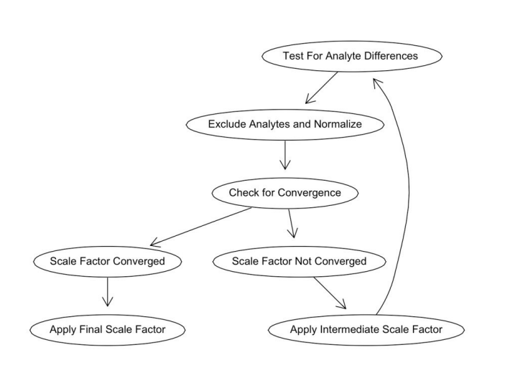
ANML – Adaptive Normalization by Maximum Likelihood
Somalogic has a healthy US population reference
Analytes that are more than 2 SD from baseline are removed from scaling
Able to normalize samples over different times and sources

Slide 41
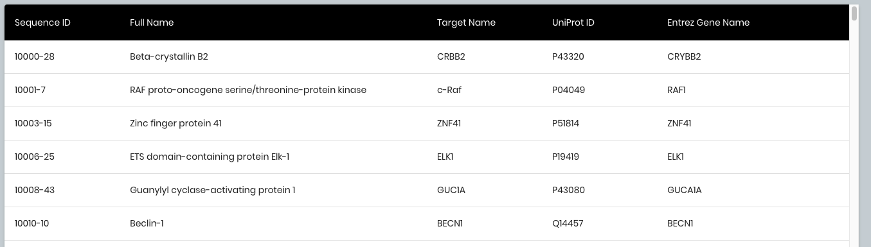
What is seq.10000.28?
Go to: https://menu.somalogic.com/
What sequence is lactase?

Slide 42
Now let’s look at Olink’s data!
Much simpler, comes in a csv format
NPX is normalized protein expression - higher NPX means more protein
Many times, the Uniprot info is given to you already!

Slide 43
Outline
Intro to Proteomics
Aptamer vs. Antibody Proteomics
Somalogic Data Processing
Association Testing & Multiplexing
Association Testing
Hands-On
pQTLs
Cis and Trans pQTLs
Hands-On
Olink Data Processing
Multiple Comparison Correction
Hands-On
Conclusion
Notes:
22 min? maybe 25?

Slide 44
Association Testing!

Slide 45
What does an association mean?
Is there a relationship between two variables?
What are the different types of variables?

Slide 46
What does an association mean?
Is there a relationship between two variables?
What are the different types of variables?
 | Categorical (Discrete) | Continuous
Example (Phenotype) | Sex, Illness | Age, BMI
Example (Proteomics) | High/Low, Quartiles | Scaled Proteomics

Slide 47
What different types of association tests are there?
Correlation
Useful for comparing two sets of continuous variables
Chi–square test
Useful for comparing two sets of categorical variables
Student’s t-test
Useful for comparing a continuous variable split by a categorical one

Slide 48
Let’s try some of them out!
Go back to the notebook!
Notes:
Q1 vs Q4 Age p-value = 2.111e-05
data: df$Sex and df$quartile104
X-squared = 14.997, df = 3, p-value = 0.001819
data: df_test$Sex and df_test$quartile104
X-squared = 11.141, df = 1, p-value = 0.0008443

Slide 49
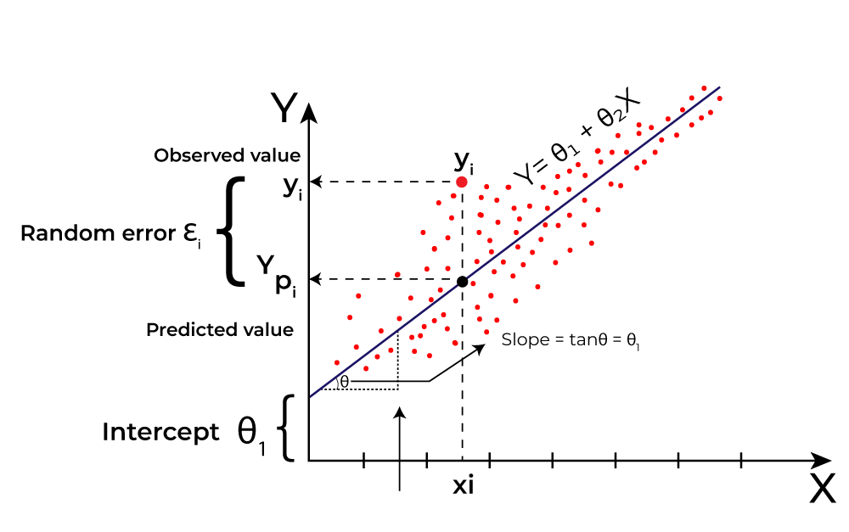
Linear Regression!
https://www.geeksforgeeks.org/machine-learning/linear-regression-real-life-examples/

Slide 50
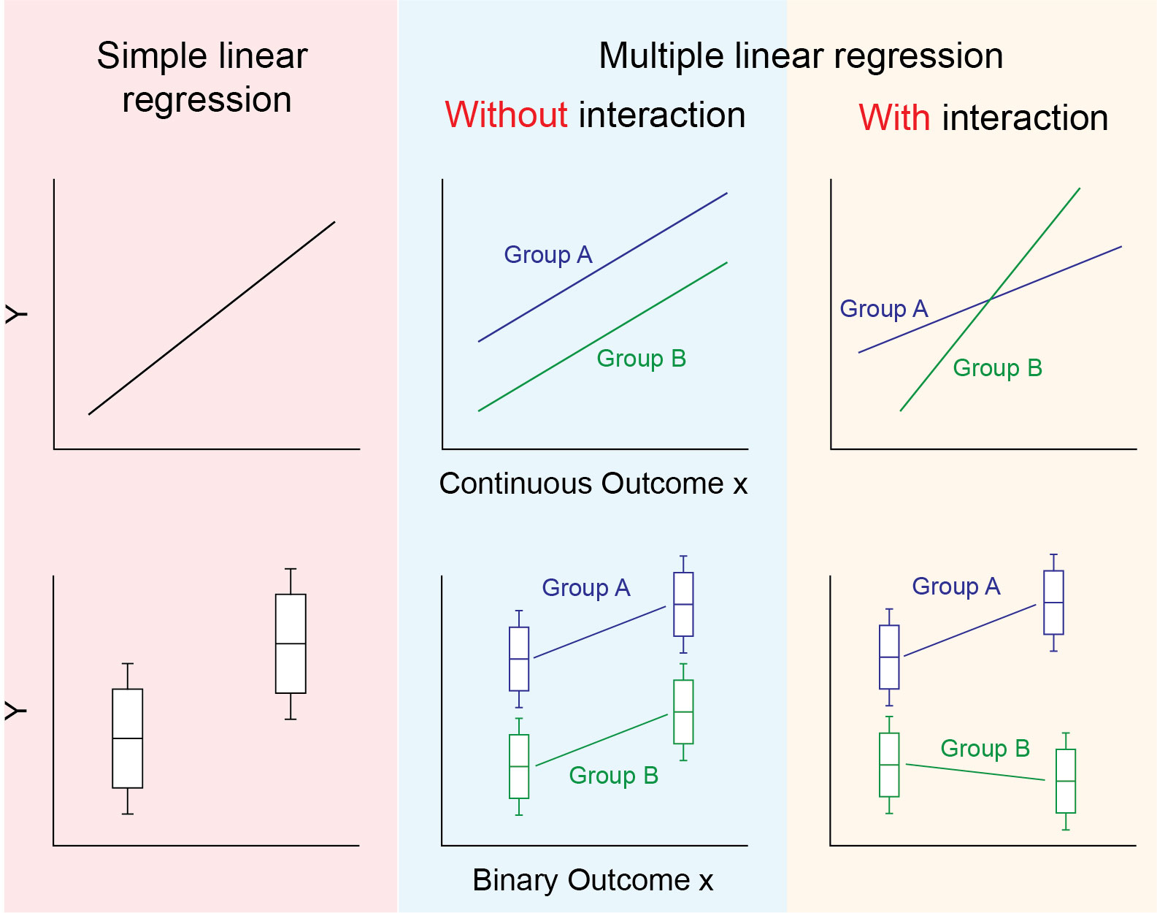
We can even use linear regression on a binary outcome!
https://bookdown.org/stephane_heritier/RM1TEST/006-interaction_collinearity.html

Slide 51
Let’s try out some basic linear regressions!
Notes:
P value for Sex is 4.37e-05 and coeff is -0.627

Slide 52
What if you have covariates?
Covariates are any variable that is possibly predictive of our outcome
They can also be confounders, mediators, or colliders
Confounder
(Smoking Status)
Exposure
(Heart Medication)
Outcome
(Heart Disease)

Slide 53
What if you have covariates?
Covariates are any variable that is possibly predictive of our outcome
They can also be confounders, mediators, or colliders
This could be its own entire workshop; for our purposes, we are going to deal with them in a simple way, but for the more complex problems, talk to a statistician!
Confounder
(Smoking Status)
Exposure
(Heart Medication)
Outcome
(Heart Disease)

Slide 54
What if you have a covariate?
https://bookdown.org/stephane_heritier/RM1TEST/006-interaction_collinearity.html

Slide 55
Problems associated with multiplexing

Slide 56
Problems associated with Multiplexing
What does a p-value mean?
A p-value of 0.04 means…

Slide 57
Problems associated with Multiplexing
What does a p-value mean?
A p-value of 0.04 means…
0.04 < 0.05 → Significant!
Reject the null hypothesis!

Slide 58
Problems associated with Multiplexing
What does a p-value mean?
A p-value of 0.04 means…
0.04 < 0.05 → Reject the null hypothesis!
But what does it actually mean?

Slide 59
Problems associated with Multiplexing
What does a p-value mean?
A p-value of 0.04 means…
0.04 < 0.05 → Reject the null hypothesis!
But what does it actually mean? 0.04 means that 4% of the time this result came from random chance

Slide 60
Problems associated with Multiplexing
If you have one or two p-values…
Not too bad, 0.05 is arbitrary anyways
Although you should keep in mind what 0.05 actually means.

Slide 61
Problems associated with Multiplexing
If you have one or two p-values…
Not too bad, 0.05 is arbitrary anyways
Although you should keep in mind what 0.05 actually means.
Would you trust a parachute if you were told that 1 out of every 20 didn’t open?

Slide 62
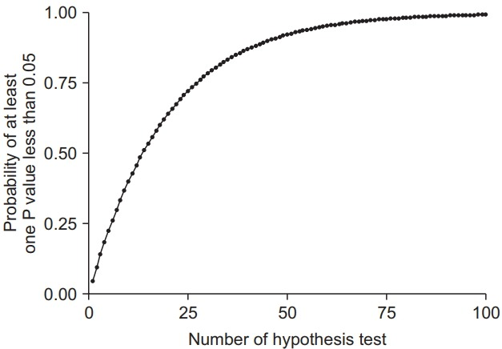
What happens when we test multiple comparisons?
How do we control for this type of error?
Do you want to make sure you limit the number of False Positives?
Or are you more worried about False Negatives?
Lee & Lee (PMID:30157585)

Slide 63
Types of Errors
Type I Error
Also known as alpha (⍺)
Number of False Positives
You say something is significant when it is not
Type II Error
Also known as beta (β)
Number of False Negatives
You say something is not significant when it is

Slide 64
Bonferroni Correction
Arguably the “simplest” correction
You divide your significance (0.05) by the number of tests
There is also an R function – p.adjust(p, method = “bonferroni”)
If you have 100 tests, your new “minimum” p-value is 0.05/100 = 0.0005
Controls for Family Wise Error Rate – the chance of making 1 or more type I errors

Slide 65
Why not use the Bonferroni correction?
One of the main assumptions is:
Each test is independent to one another Let’s say you are looking at interleukin responses in a sample

Slide 66
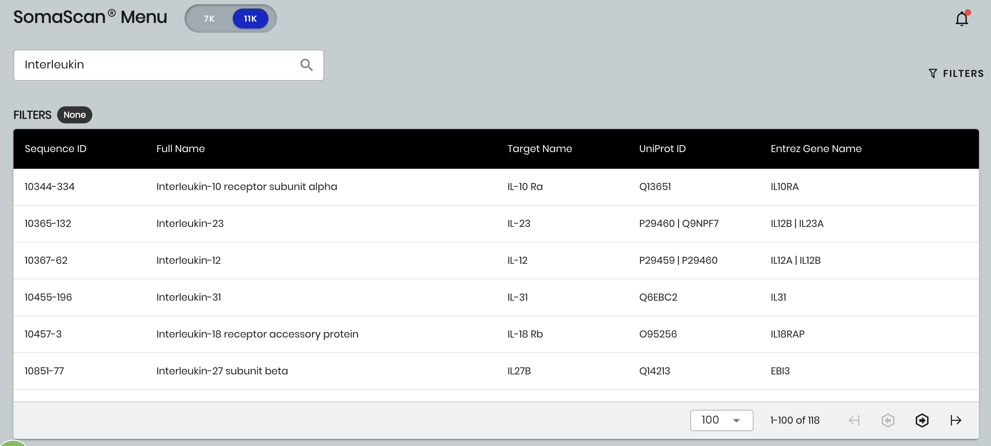
Why not use the Bonferroni correction?

Slide 67
Why not use the Bonferroni correction?

Slide 68
Why not use the Bonferroni correction?
When a correlation or association exists between tests, you increase the chance of a type II error

Slide 69
Benjamini–Hochberg Procedure
Sometimes just called “FDR” – False Discovery Rate
Allows for a certain percentage of False Positives while limiting the number of False Negatives
Sorts the p-values in ascending order and reject the null hypothesis for the top “k” p-values
“k” is determined by a critical value - (i/m)Q

Slide 70
Benjamini–Hochberg Procedure
R has a built in function – p.adjust(p, method = “BH”)
BH allows for positive dependence between your comparisons
If your dataset has a lot of negative dependence – look into other comparisons
A really interesting arxiv paper claims that using BH with negative dependence only inflates FDR by a constant factor

Slide 71
Types of MC Corrections
Bonferroni
Simple
Very Conservative
Corrects for Family Wise Error Rate (FWER)
Benjamini–Hochberg
Harder to calculate
Gives you more power
Corrects for False Discovery Rate (FDR)

Slide 72
Outline
Intro to Proteomics
Aptamer vs. Antibody Proteomics
Somalogic Data Processing
Association Testing & Multiplexing
Association Testing
Hands-On
pQTLs
Cis and Trans pQTLs
Hands-On
Olink Data Processing
Multiple Comparison Correction
Hands-On
Conclusion
Notes:
22 min? maybe 25?

Slide 73
Protein Quantitative Trait Loci

Slide 74
What is a pQTL?
A locus or spot on the genome that has an impact (increases or decreases) on a quantitative trait
In this case, protein levels
There are two types of pQTLs: cis and trans
This is in essence: a protein GWAS

Slide 75
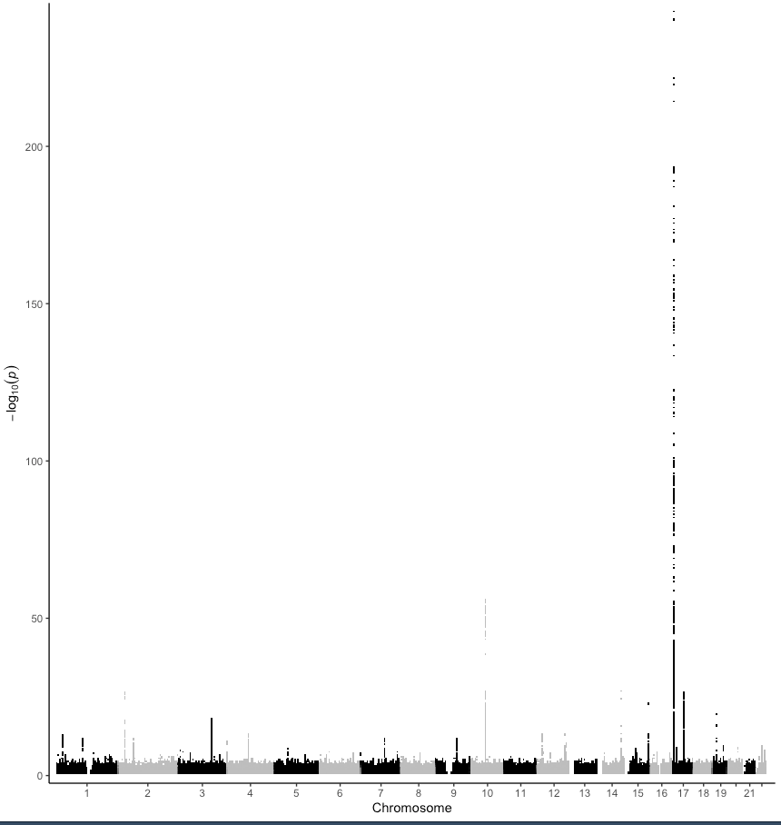
What is a protein quantitative trait locus (pQTL)?
Cis pQTL
Gene X
Protein X
A/T
Trans pQTL
Gene Y
Protein X
T/C

Slide 76
How to go about finding pQTLs
You need a cohort with both genetic sequencing AND proteomic information
For the purposes of this workshop, you will be provided with a fake set of genetic data
We will be using PLINK for our analysis but there’s tons of software that allow you to conduct association testing

Slide 77
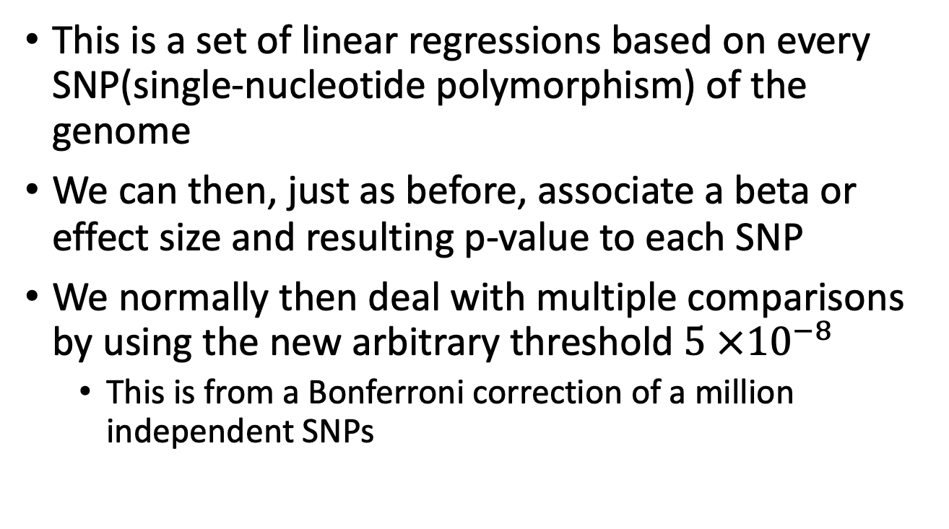
What is a continuous phenotype GWAS?
This is a set of linear regressions based on every SNP(single-nucleotide polymorphism) of the genome
We can then, just as before, associate a beta or effect size and resulting p-value to each SNP
We normally then deal with multiple comparisons by using the new arbitrary threshold $5 ×{10}^{−8}$
This is from a Bonferroni correction of a million independent SNPs

Slide 78
Genetic File Formats
We will be using PLINK 1.9 as our software of choice and its resulting file formats
.bed file
Binary representation of the genotype calls
.fam file
Text file describing the samples or participants in the bed file (Family ID, Sample ID, Sex, and phenotype value)
.bim file
Text file describing the variants in the bed file (Chromosome, ID, position/coordinates, and alleles)

Slide 79
As a forewarning:
This workshop is not designed to teach you how to QC, merge, run a PCA, or even LD prune your genetic datasets
We have another workshop called “Data Processing for Genetics” which will cover that in depth.
This toy dataset will give you an unrealistic result but will show you the steps to run actual data.

Slide 80
Scaling pt. 2
One of the things we can do to ensure that all of our phenotypes are normally distributed is to scale with Rank Inverse Normal Transformation

Slide 81
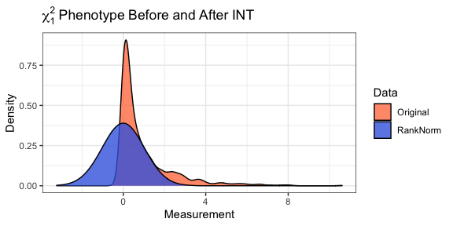
Scaling pt. 2
One of the things we can do to ensure that all of our phenotypes are normally distributed is to scale with Rank Inverse Normal Transformation
Notes:
Prior to scaling beta is -0.2519 and p-value is: 6.012e-13

Slide 82
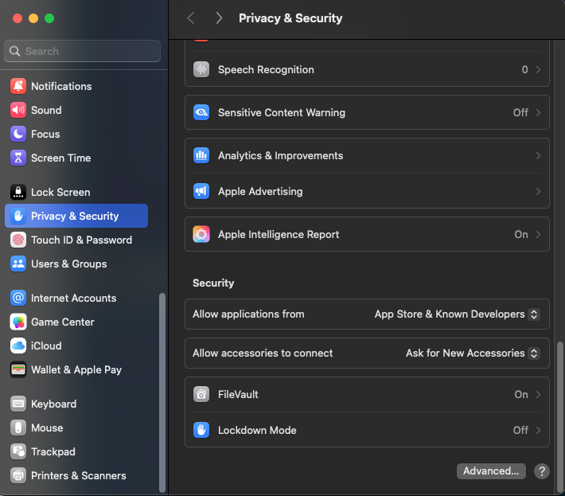
PLINK Installation and First-time running
For Mac:

Slide 83
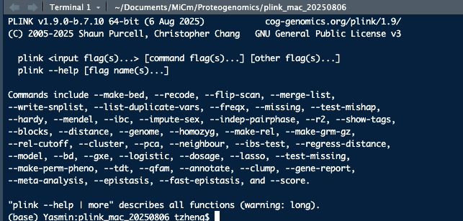
PLINK Installation and First-time running
You should see something like this!

Slide 84
Some reminders
GWAS results are not causal results!
We still need to say “associated with”
Unless the SNP itself has already been proven to be deleterious clinically.

Slide 85
In summary
We have talked about different types of Proteomics
We discussed the data formatting for both Somalogic and Olink
We discussed how scaling your phenotypes impacts your analysis
We did some basic association tests
Discussed what happens when you conduct multiple comparisons
Discuss how to find and annotate pQTLs

Slide 86



Thank you for attending!
1
2
3
Scan the QR code to confirm you attended today’s workshop.
Fill out the feedback survey in the next 72h.
Get recognition for this workshop on your
co-curricular record.

Slide 87
Thank you for attending!
1
2
3
Scan the QR code to confirm you attended today’s workshop.
Fill out the feedback survey in the next 72h.
Get recognition for this workshop on your
co-curricular record.

